Slide 1
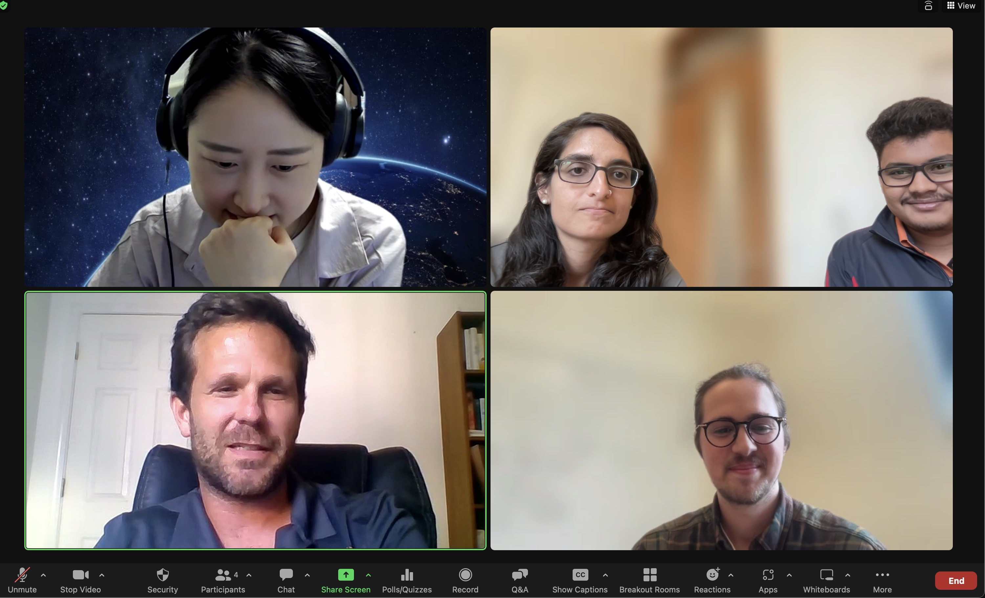
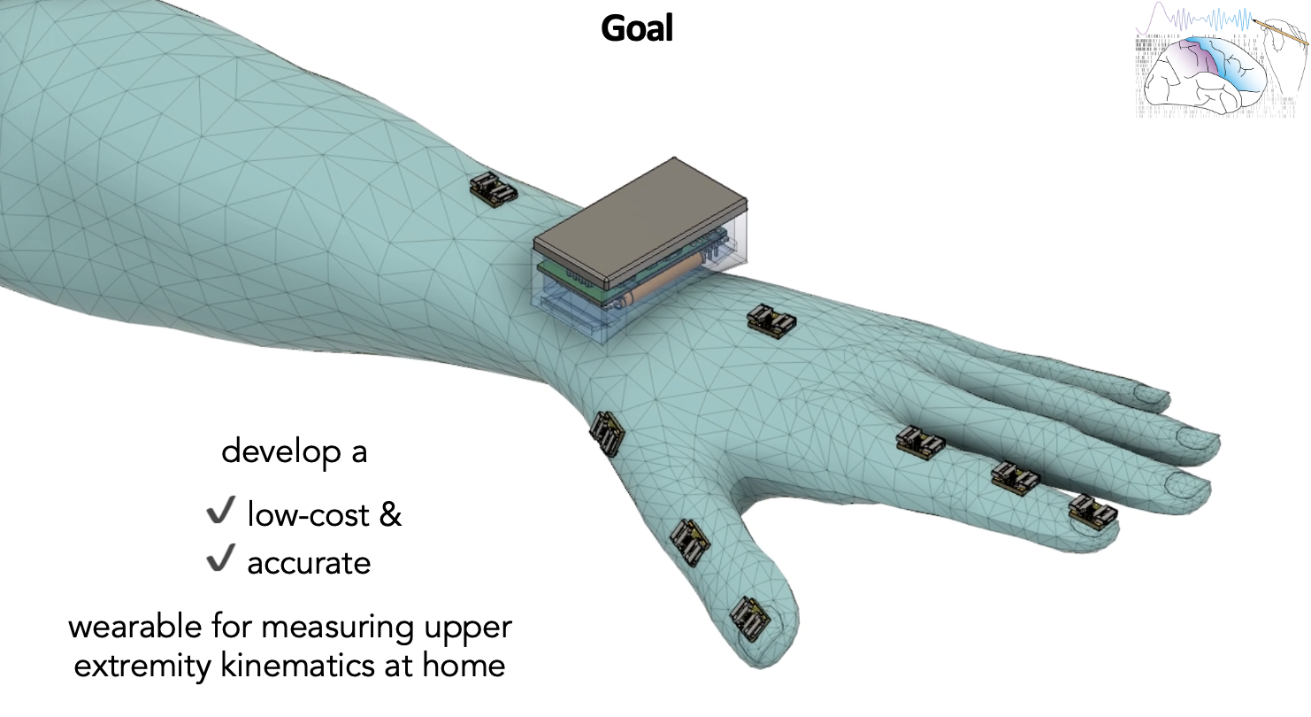

Slide 2
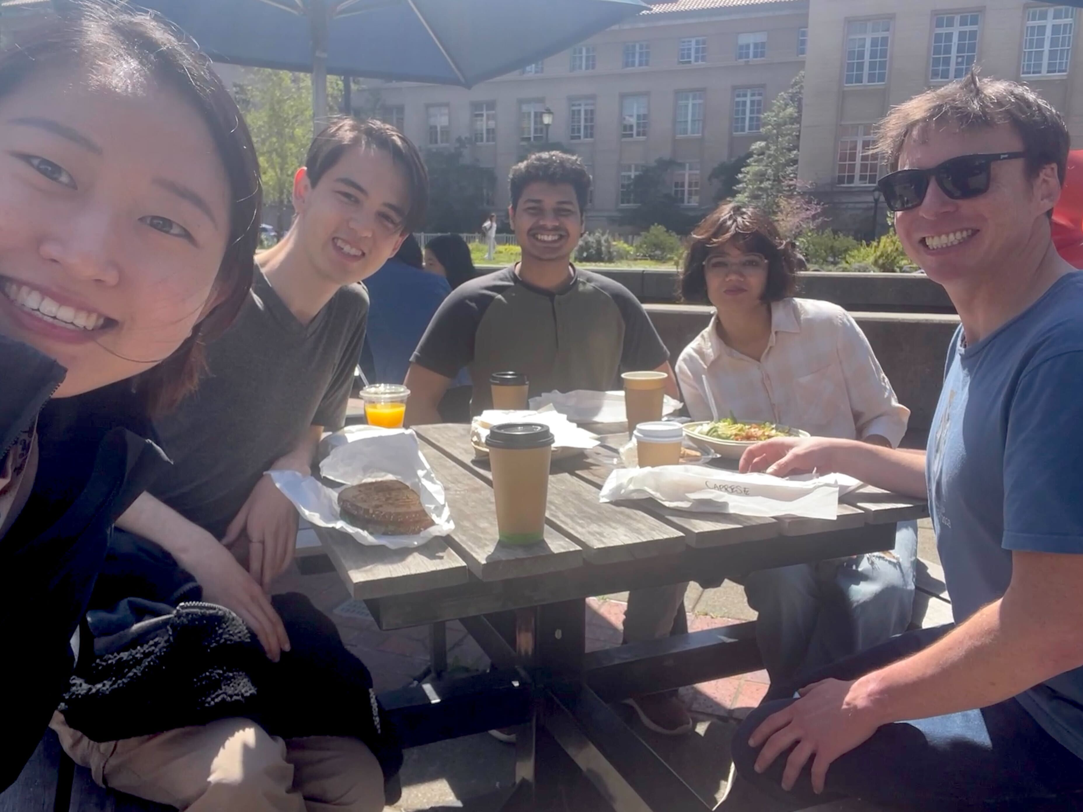

Slide 3
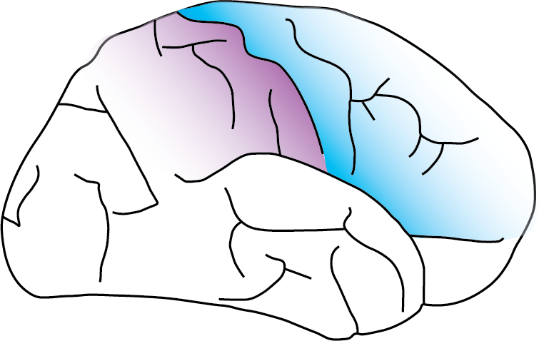
Welcome to the
Sensorimotor Neural Engineering Lab
@ UC Berkeley!

Slide 4
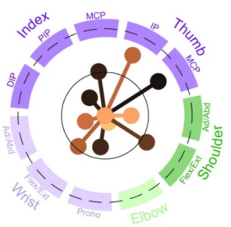

Slide 5
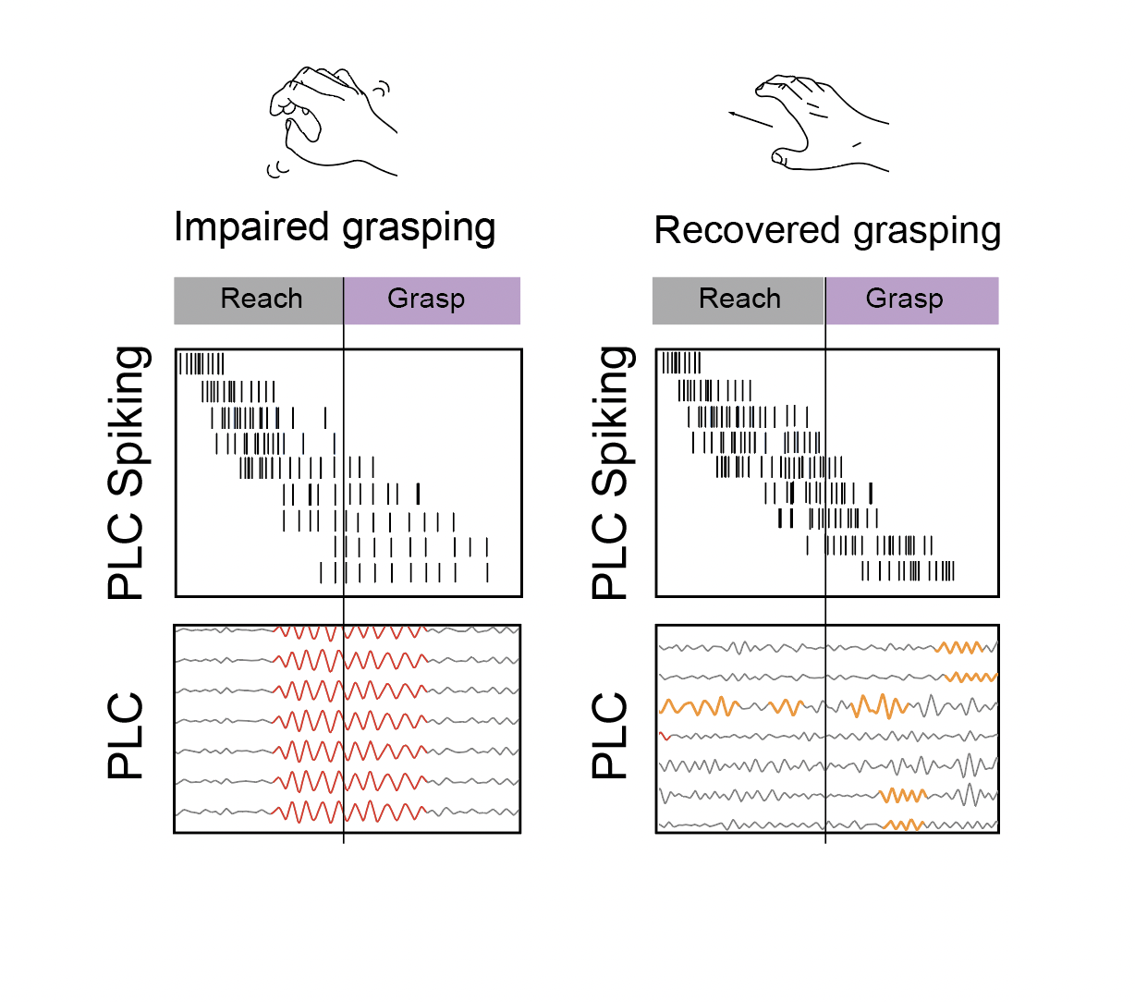
Global beta dominant
Local beta dominant

Slide 6
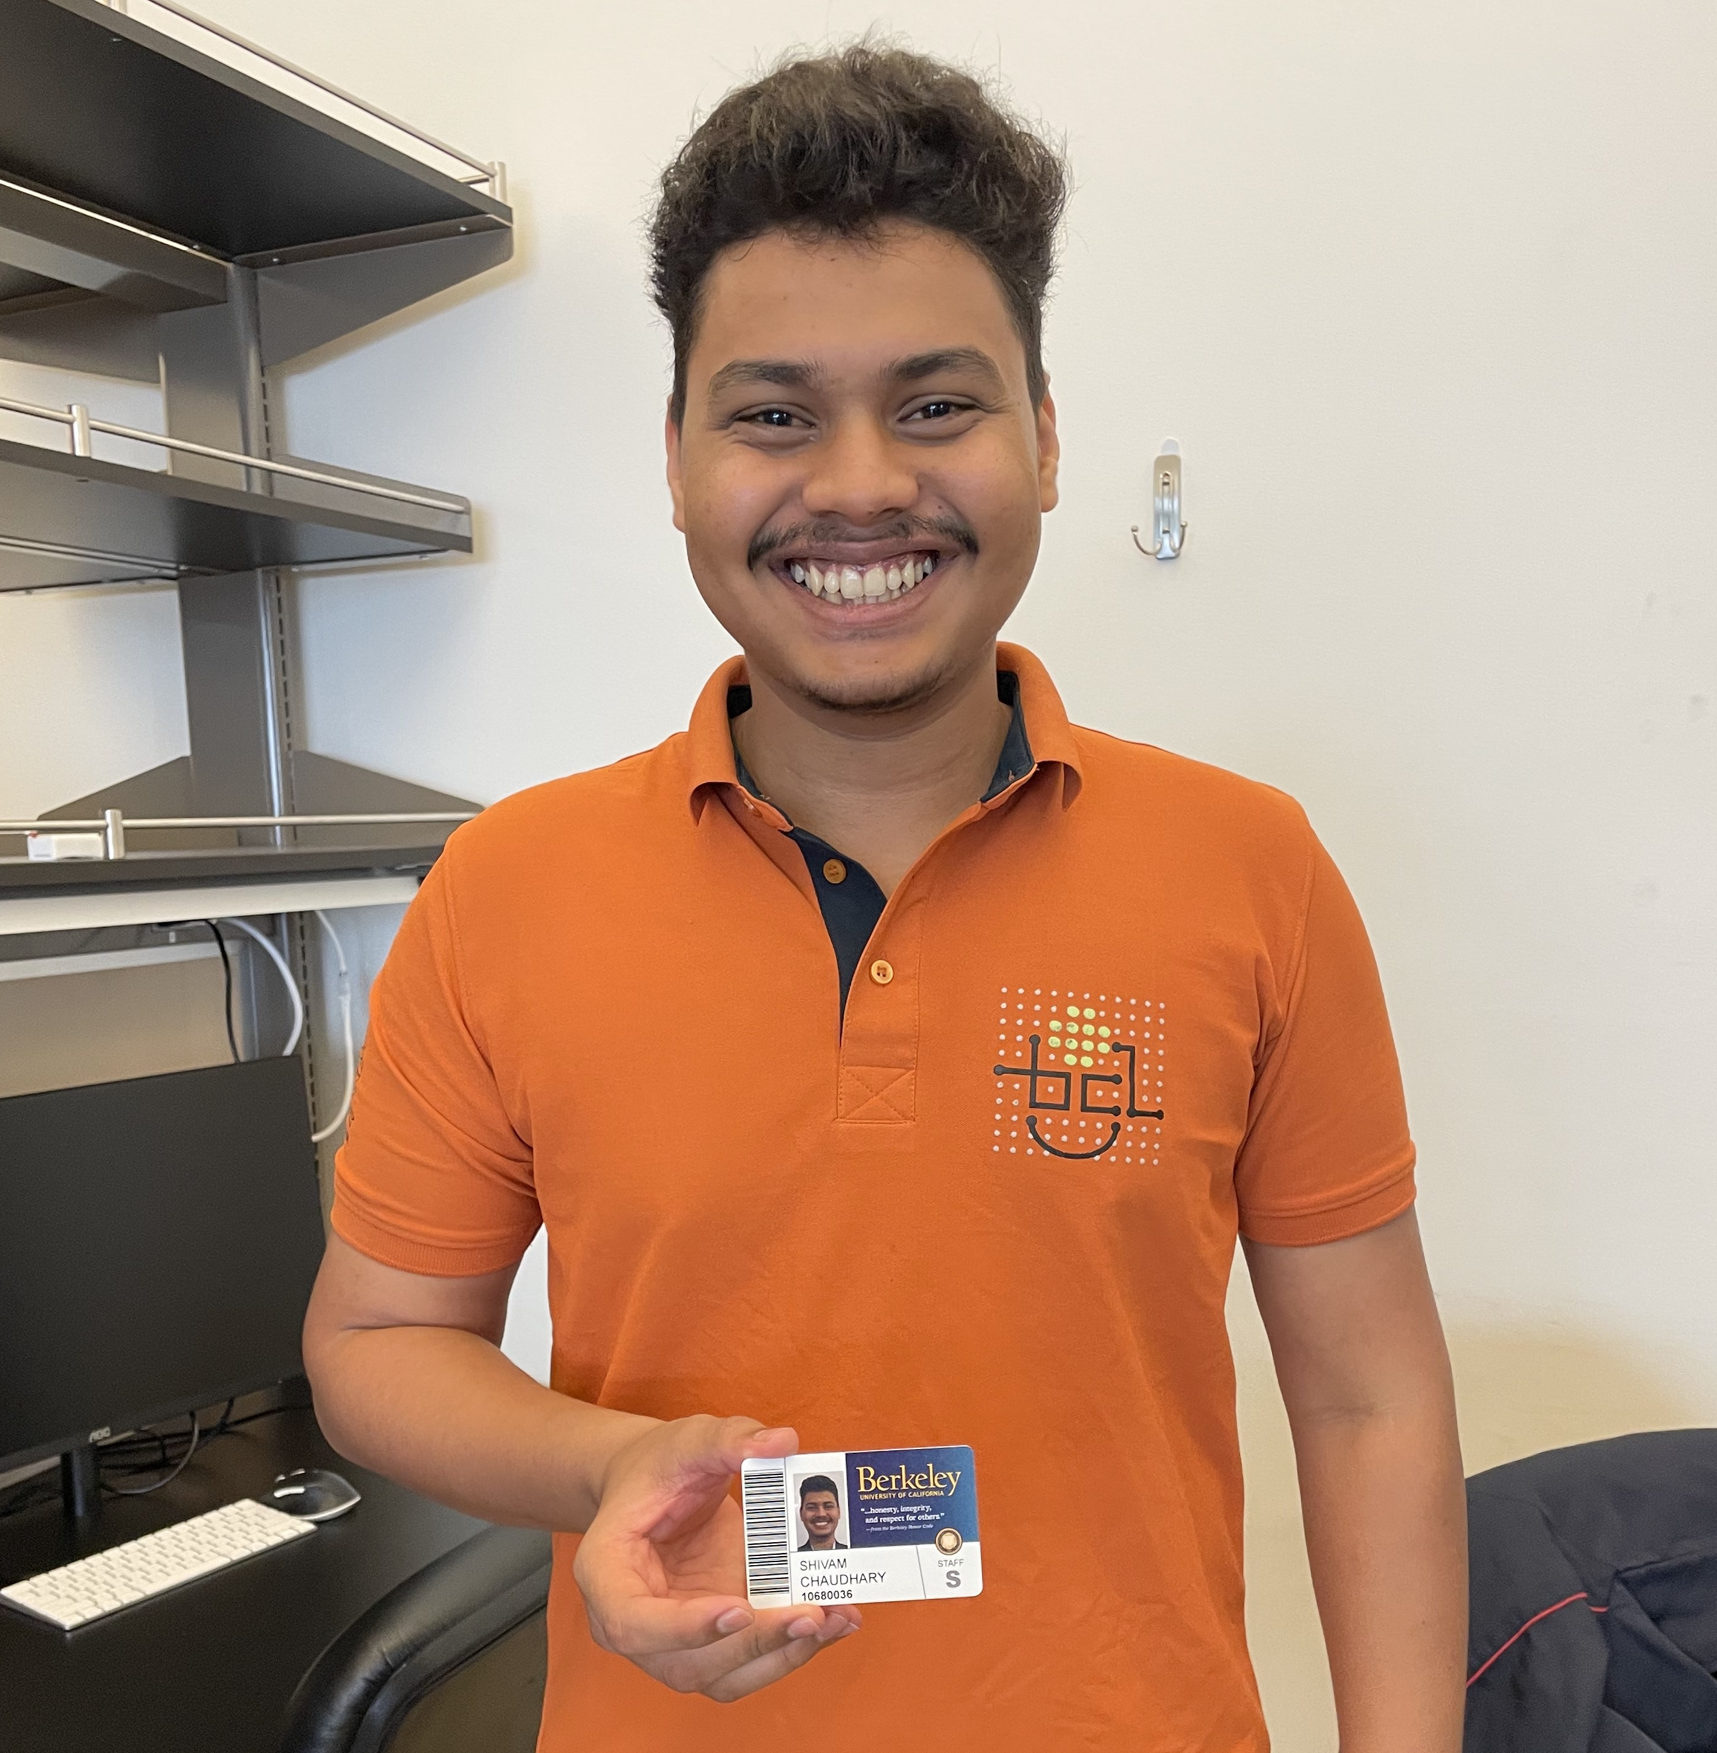

Slide 7
Sim
Co

Slide 8


Slide 9


Slide 10
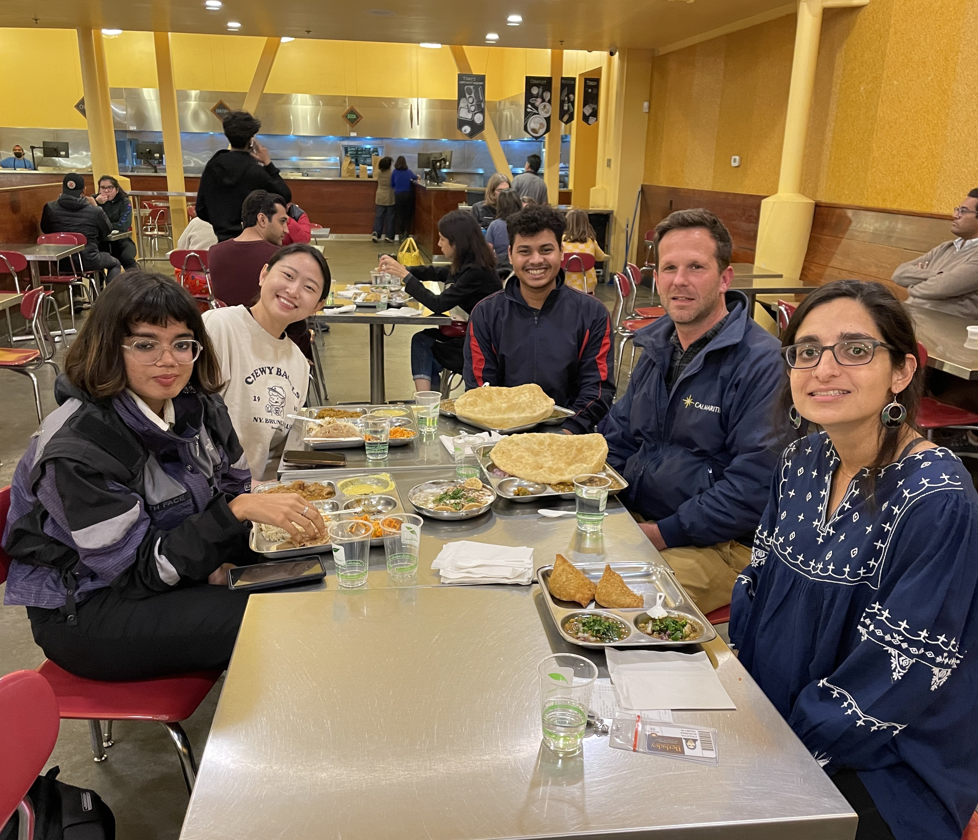

Slide 11
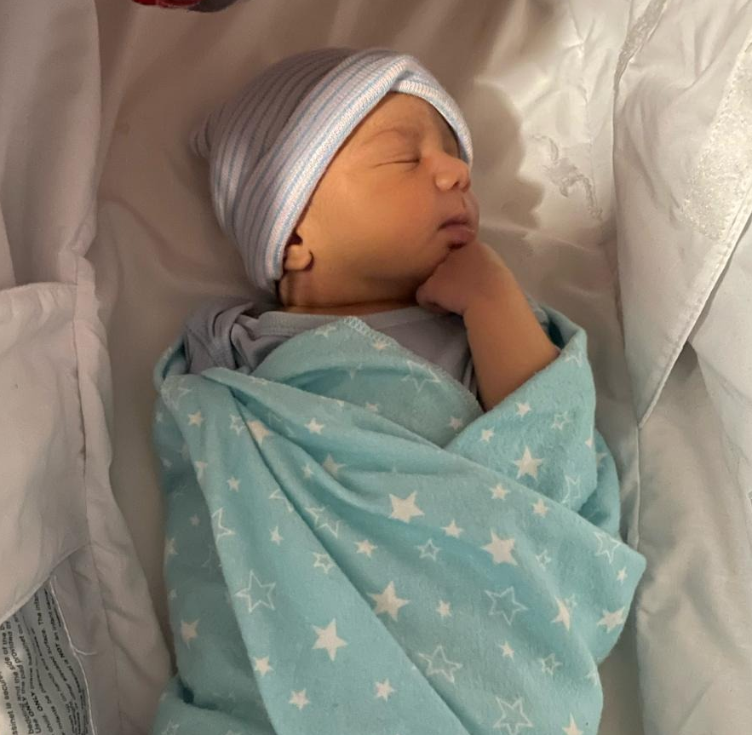

Slide 12


Slide 13


Slide 14


Slide 15


Slide 16
